Slide 1
Life Legacy Project
Presented by: Brooke Rodriguez, MSWi
February 16, 2007
Notes:
This is the life legacy project training presented by me brooke Rodriguez

Slide 2
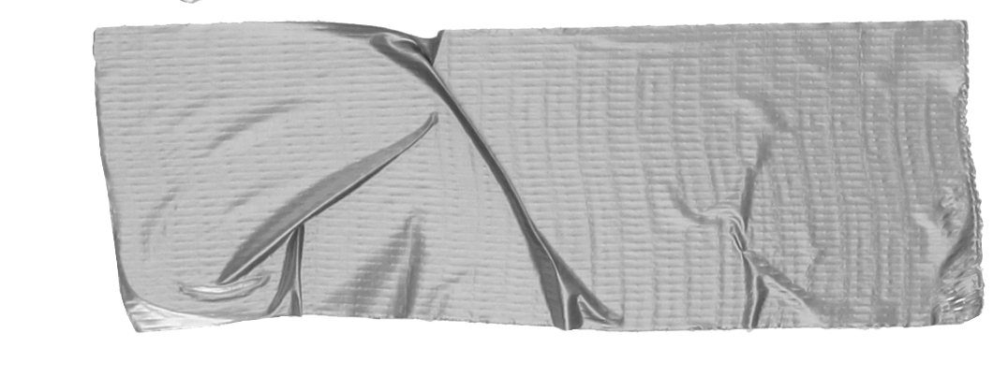
Life Legacy Introduction
Why it was created What it involves Benefits Your role
SLR: typically done over several sessions and chronological from birth to present with the summarization and evaluation of the patient’s life
RT: an informal discussion with the patient about past activities, experiences, and events. Typically involves tangible props and often done in groups.
Notes:
Life Legacy was created to give patients a clearer understanding of the significance of their life. We want to validate their accomplishments, help to overcome their fears and failures, and be of support through the process of forgiveness.
Life Legacy has integrated a shortened version of a Structured Life Review and Reminiscence Therapy. A Structured Life Review is typically done over several sessions and chronological from birth to present with the summarization and evaluation of the patient’s life (Haight & Haight, 2007).
Reminiscence Therapy is an informal discussion with the patient about past activities, experiences, and events and typically involves tangible props. This therapy is often done within groups (Woods et al., 2005)
There is a lot of research on Structured Life Reviews and Reminiscence Therapy that state the benefits to patients in palliative care, such as reduced depression and existential concerns. But Because this training does not go in-depth enough to fully train a you all, we cannot say the Life Legacy project will prove beneficial for every patient.
We do know that most patient’s enjoy sharing their stories and would love to have it put in writing to give their loved ones.
If all we do is help a patient to relive memories and leave something for their families to cherish forever, than we have succeeded.
And lastly Your role in this experience with the patient is to be present, listen, and help them relive their memories and feelings.

Slide 3
Appropriate Patients
Not actively dying
Not cognitively impaired
Notes:
Appropriate patients, not all patients are going to be appropriate for this project. Its pretty obvious that if a patient is showing signs of actively dying we wouldn't be trying to get them to share life stories. Also, if the patient is cognitively impaired it would be very hard to get accurate stories, as well as it may cause unneeded stress to the patients trying to remember facts.
With that being said there was a patient that had glioblastoma of the brain and it was very therapeutic for him to write letters to his loved ones and they didn’t all make sense, but it served a purpose. And then there was a patient that was completely competent had amazing stories of escaping enemy in WWII received the bronze star, but he did not want anything written about him or his story.
You are trained to assess your patient’s needs and well being, we trust that you will be able to decide whether your patient is a good candidate. If you have questions or concerns contact the volunteer coordinator.

Slide 4
Confidentiality
Consent form
Everything shared is confidential
Pictures or recordings must be deleted after use
USB drive must be password protected
Notes:
Before beginning any project with the patient a consent form will need to be signed by the patient or person responsible. Like everything within Mission, everything shared is confidential. Pictures must be transported in an envelope, or if scanned on the phone or computer must be deleted after used. Recordings must be deleted and anything saved on an usb must be deleted. Also if personal USBs are used they must be password protected.

Slide 5
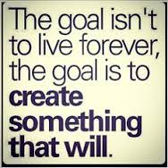
The Projects…
All About Me
Dear Friends and Family (Stanford Medical)
Memories Photo Book
Notes:
There are three projects within Life Legacy:
All About Me
Dear Friends and Family
Memories Photo Book
All about me is a list of questions the patient gets to choose from to answer.
Dear Friends and Family is a letter template created by Stanford Medicine addressed to the patients’ loved ones.
Memories Photo Book is a scrapbook with the patients’ most cherished photos.

Slide 6
All About Me Patient will answer questions Or just tell about important memories in their life You will be the facilitator to make the memories come back to life Give it a title!
Notes:
All about me consists of a patient choosing off a list of questions to answer or just tell about important memories or experiences in their life. Help them to bring those memories back to life. The questions are listed in life stages, and they can choose a theme or just free flow. If they are not offering a lot of information ask them open ended questions i.e. how the experience felt, what were the inspirations or consequences from that experience, what did they learn from it, how they feel now about that memory.
When you're finished they can name their life story. Give it a name that summarizes their life or simply just their own name.
If you for some reason you are not comfortable completing the project after it has been started please let the volunteer coordinator know.

Slide 7
Dear Friends and Family
Created by Stanford Medical
Completes the 7 vital tasks of a life review
There is a template but patient can choose to write their own
Notes:
Stanford Medicine created a letter template to give all individuals an opportunity to complete the seven vital tasks of a life review:
Acknowledge the important people in your life
Remember treasured moments from your life
Apologize to those you love if you’ve hurt them
Forgive those who have hurt you
Express the gratitude for all the care and love you have received
Tell your friends and family how much you love them
Take a moment to say “goodbye”
On the web site they give you templates in several different languages as well.
This is only a simple way to complete a letter to loved ones, if the patient would rather write a letter on their own to their loved ones assist them in that.
You would want to also write in past or present tense depending when the patient would want to give their loved ones their letters.

Slide 8
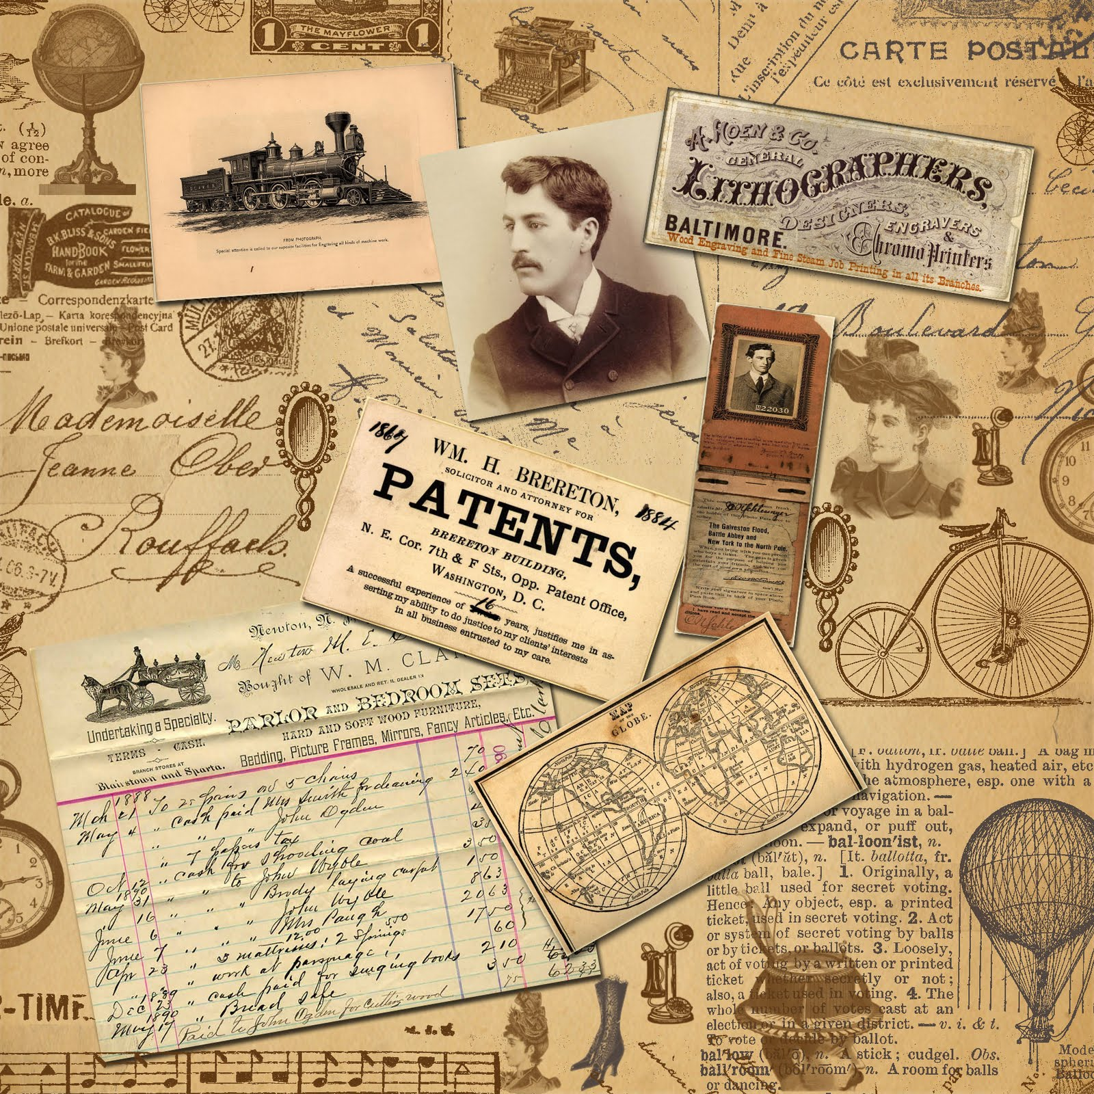
Memories Photo Book
Scrapbook of patient’s most cherished photos
Themed or random
You are the facilitator to make those pictures come back to life
Give it a title!
Notes:
This is a scrapbook of the patients most treasured moments or favorite photographs. They can make it a themed book like their favorite vacations or just random photos. When getting their photos cans questions like:
Who is in the picture
When was it taken
Where was it taken
What were they doing
What was the weather like
What were their feelings during that time
A lot of time patients have albums full of photos that no one looks at this could be an easy way to put together their most cherished ones and talk about them.
Let them title their book!

Slide 9
Cultural Differences
Not all patients will be willing to talk about the same things Let them lead the way…
Notes:
So this doesn’t totally affect this project, because if the patient doesn’t want to talk about their illness or the end of life you will have known that by this point being their volunteer. Also, the patient is choosing what they want to talk about so they wouldn’t choose questions they were comfortable answering. But some cultures don’t talk about them being sick, or some people only focus on the positive aspects in life. Let the patient lead the way.

Slide 10
Overwhelmed…
Ask the patient
Slow down
Stop
Notes:
If it seems that your patient is becoming over whelmed with the project ask them, and slow the pace, if it still conts maybe stop for a while or all together. You are all trained to know your patients attitudes, so you will know what's best and if the project should cont or not.

Slide 11
Finalizing the Projects
Edit..Edit…Edit Templates All About Me/Memories Photo Book Dear Friends and Family
Notes:
There are templates for all the projects on USBs. For all the projects there is certain paper to print them out on. For the all about me and the memories photobook there are clear folders to put them in and for the dear friends and family there are envelopes.

Slide 12
Thank You!
Notes:
Thank you for taking the time to complete a project with your patient! Everyone at Mission Hospice thanks you for giving your time for the patients.
Also if you want to learn more about structured life reviews research dignity therapy by harvey max chochinov.

